Slide 1
Chapter 6
Writing a Program
Bjarne Stroustrup
www.stroustrup.com/Programming

Slide 2
Abstract
This lecture and the next describe the process of designing a program through the example of a simple “desk calculator.”
Stroustrup/Programming/2015

Slide 3
Overview
Some thoughts on software development
The idea of a calculator
Using a grammar
Expression evaluation
Program organization
Stroustrup/Programming/2015

Slide 4
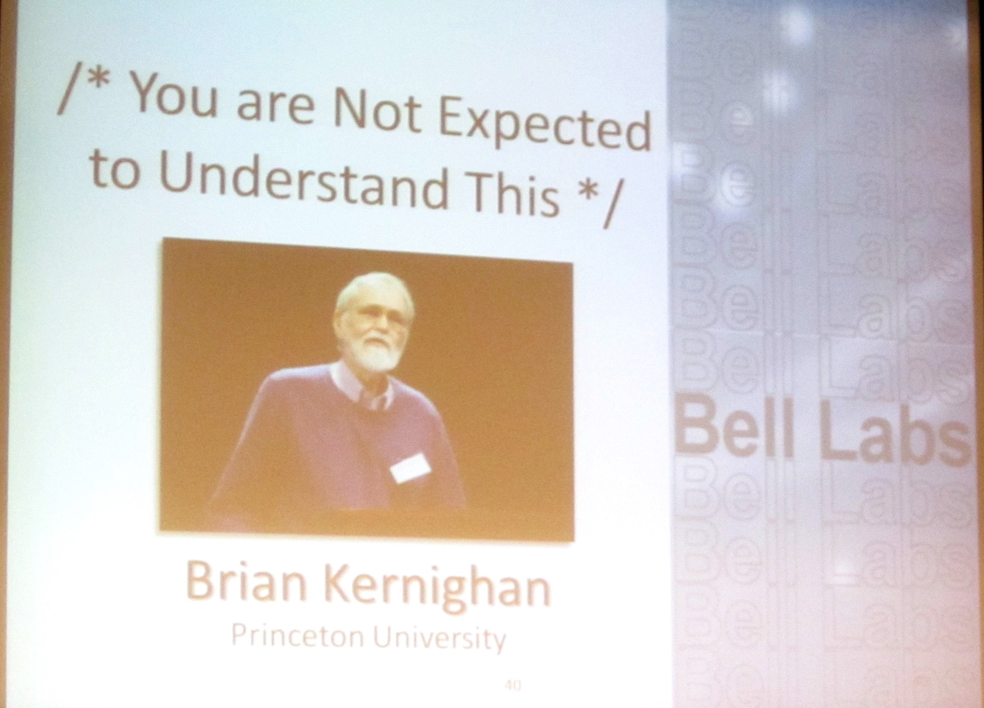
Stroustrup/Programming/2015
Notes:
A famous quote in the original Unix source code. You can’t understand everything – certainly not at first and in detail.
BWK giving a memorial lecture for Dennis Ritchie, the designer of the C programming language.

Slide 5
Building a program
Analysis
  Refine our understanding of the problem
    Think of the final use of our program
Design
  Create an overall structure for the program
Implementation
  Write code
  Debug
  Test
Go through these stages repeatedly
Stroustrup/Programming/2015

Slide 6
Writing a program: Strategy
What is the problem to be solved?
  Is the problem statement clear?
  Is the problem manageable, given the time, skills, and tools available?
Try breaking it into manageable parts
  Do we know of any tools, libraries, etc. that might help?
    Yes, even this early: iostreams, vector, etc.
Build a small, limited version solving a key part of the problem
  To bring out problems in our understanding, ideas, or tools
  Possibly change the details of the problem statement to make it manageable
If that doesn’t work
  Throw away the first version and make another limited version
  Keep doing that until we find a version that we’re happy with
Build a full scale solution
  Ideally by using part of your initial version
Stroustrup/Programming/2015

Slide 7
Programming is also a practical still
We learn by example
  Not by just seeing explanations of principles
  Not just by understanding programming language rules
The more and the more varied examples the better
  You won’t get it right the first time
  “You can’t learn to ride a bike from a correspondence course”
Stroustrup/Programming/2015

Slide 8
Writing a program: Example
I’ll build a program in stages, making lot of “typical mistakes” along the way
  Even experienced programmers make mistakes
    Lots of mistakes; it’s a necessary part of learning
  Designing a good program is genuinely difficult
  It’s often faster to let the compiler detect gross mistakes than to try to get every detail right the first time
    Concentrate on the important design choices
  Building a simple, incomplete version allows us to experiment and get feedback
    Good programs are “grown”
Stroustrup/Programming/2015

Slide 9
A simple calculator
Given expressions as input from the keyboard, evaluate them and write out the resulting value
  For example
    Expression: 2+2
    Result: 4
    Expression: 2+2*3
    Result: 8
    Expression: 2+3-25/5
    Result: 0
Let’s refine this a bit more …
Stroustrup/Programming/2015

Slide 10
Pseudo Code
A first idea:
    int main()
    {
    variables // pseudo code
    while (get a line) { // what’s a line?
    analyze the expression // what does that mean?
    evaluate the expression
    print the result
    }
    }
How do we represent 45+5/7 as data?
How do we find 45 + 5 / and 7 in an input string?
How do we make sure that 45+5/7 means 45+(5/7) rather than (45+5)/7?
Should we allow floating-point numbers (sure!)
Can we have variables? v=7; m=9; v*m (later)
Stroustrup/Programming/2015

Slide 11
A simple calculator
Wait!
  We are just about to reinvent the wheel!
  Read Chapter 6 for more examples of dead-end approaches
What would the experts do?
  Computers have been evaluating expressions for 50+ years
  There has to be a solution!
  What did the experts do?
    Reading is good for you
    Asking more experienced friends/colleagues can be far more effective, pleasant, and time-effective than slogging along on your own
    “Don’t re-invent the wheel”
Stroustrup/Programming/2015

Slide 12
Expression Grammar
This is what the experts usually do – write a grammar:
Expression :
Term
Expression ‘+’ Term e.g., 1+2, (1-2)+3, 2*3+1
Expression ‘-’ Term
Term :
Primary
Term ‘*’ Primary e.g., 1*2, (1-2)*3.5
Term ‘/’ Primary
Term ‘%’ Primary
Primary :
Number e.g., 1, 3.5
‘(‘ Expression ‘)’ e.g., (1+2*3)
Number :
floating-point literal e.g., 3.14, 0.274e1, or 42 – as defined for C++
A program is built out of Tokens (e.g., numbers and operators).
Stroustrup/Programming/2015

Slide 13
A side trip: Grammars
What’s a grammar?
  A set of (syntax) rules for expressions.
    The rules say how to analyze (“parse”) an expression.
  Some rules seem hard-wired into our brains
  Example, you know what this means:
    2*3+4/2
    birds fly but fish swim
  You know that this is wrong:
    2 * + 3 4/2
    fly birds fish but swim
  How can we teach what we know to a computer?
    Why is it right/wrong?
    How do we know?
Stroustrup/Programming/2015

Slide 14
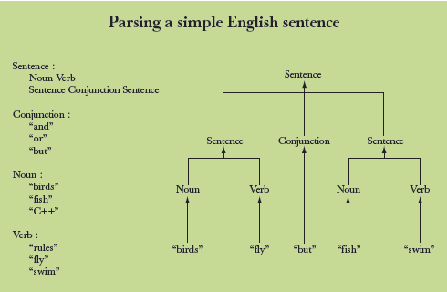
Grammars – “English”
Stroustrup/Programming/2015

Slide 15
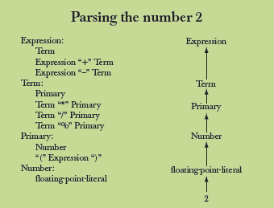
Grammars - expression
Stroustrup/Programming/2015

Slide 16
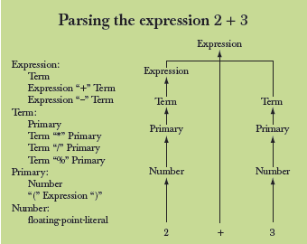
Grammars - expression
Stroustrup/Programming/2015

Slide 17
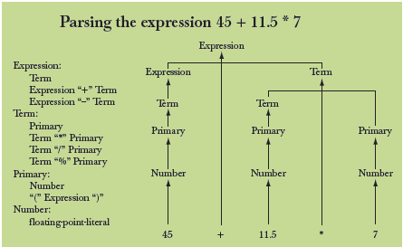
Grammars - expression
Stroustrup/Programming/2015

Slide 18
Functions for parsing
We need functions to match the grammar rules
  get() // read characters and compose tokens
  // calls cin for input
  expression() // deal with + and –
  // calls term() and get()
  term() // deal with *, /, and %
  // calls primary() and get()
  primary() // deal with numbers and parentheses
  // calls expression() and get()
Note: each function deals with a specific part of an expression and leaves
everything else to other functions – this radically simplifies each function.
Analogy: a group of people can deal with a complex problem by each person
handling only problems in his/her own specialty, leaving the rest for colleagues.
Stroustrup/Programming/2015

Slide 19
Function Return Types
What should the parser functions return?
  How about the result?
  Token get_token(); // read characters and compose tokens
  double expression(); // deal with + and –
  // return the sum (or difference)
  double term(); // deal with *, /, and %
  // return the product (or …)
  double primary(); // deal with numbers and parentheses
  // return the value
What is a Token?
Stroustrup/Programming/2015

Slide 20
What is a token?
number
+
4.5
We want to see input as a stream of tokens
  We read characters 1 + 4*(4.5-6) (That’s 13 characters incl. 2 spaces)
  9 tokens in that expression: 1 + 4 * ( 4.5 - 6 )
  6 kinds of tokens in that expression: number + * ( - )
We want each token to have two parts
  A “kind”; e.g., number
  A value; e.g., 4
We need a type to represent this “Token” idea
  We’ll build that in the next lecture, but for now:
    get_token() gives us the next token from input
    t.kind gives us the kind of the token
    t.value gives us the value of the token
Stroustrup/Programming/2015

Slide 21
Dealing with + and -
Expression:
Term
Expression '+' Term // Note: every Expression starts with a Term
Expression '-' Term
double expression() // read and evaluate: 1 1+2.5 1+2+3.14 etc.
{
double left = term(); // get the Term
while (true) {
Token t = get_token(); // get the next token…
switch (t.kind) { // … and do the right thing with it
case '+': left += term(); break;
case '-': left -= term(); break;
default: return left; // return the value of the expression
}
}
}
Stroustrup/Programming/2015

Slide 22
Dealing with *, /, and %
double term() // exactly like expression(), but for *, /, and %
{
double left = primary(); // get the Primary
while (true) {
Token t = get_token(); // get the next Token…
switch (t.kind) {
case '*': left *= primary(); break;
case '/': left /= primary(); break;
case '%': left %= primary(); break;
default: return left; // return the value
}
}
}
Oops: doesn’t compile
  % isn’t defined for floating-point numbers
Stroustrup/Programming/2015

Slide 23
Dealing with * and /
Term :
Primary
Term ‘*’ Primary // Note: every Term starts with a Primary
Term ‘/’ Primary
double term() // exactly like expression(), but for *, and /
{
double left = primary(); // get the Primary
while (true) {
Token t = get_token(); // get the next Token
switch (t.kind) {
case '*': left *= primary(); break;
case '/': left /= primary(); break;
default: return left; // return the value
}
}
}
Stroustrup/Programming/2015

Slide 24
Dealing with divide by 0
double term() // exactly like expression(), but for * and /
{
double left = primary(); // get the Primary
while (true) {
Token t = get_token(); // get the next Token
switch (t.kind) {
case '*':
left *= primary();
break;
case '/':
{ double d = primary();
if (d==0) error("divide by zero");
left /= d;
break;
}
default:
return left; // return the value
}
}
}
Stroustrup/Programming/2015

Slide 25
Dealing with numbers and parentheses
double primary() // Number or ‘(‘ Expression ‘)’
{
Token t = get_token();
switch (t.kind) {
case '(': // handle ‘(’expression ‘)’
{ double d = expression();
t = get_token();
if (t.kind != ')') error("')' expected");
return d;
}
case '8': // we use ‘8’ to represent the “kind” of a number
return t.value; // return the number’s value
default:
error("primary expected");
}
}
Stroustrup/Programming/2015

Slide 26
Program organization
Token
error()
get_token()
primary()
term()
istream
cin
>>
expression()
ostream
cout
<<
main()
Who calls whom? (note the loop)
Stroustrup/Programming/2015

Slide 27
The program
#include "std_lib_facilities.h"
// Token stuff (explained in the next lecture)
double expression(); // declaration so that primary() can call expression()
double primary() { /* … */ } // deal with numbers and parentheses
double term() { /* … */ } // deal with * and / (pity about %)
double expression() { /* … */ } // deal with + and –
int main() { /* … */ } // on next slide
Stroustrup/Programming/2015

Slide 28
The program – main()
int main()
try {
while (cin)
cout << expression() << '\n';
keep_window_open(); // for some Windows versions
}
catch (runtime_error& e) {
cerr << e.what() << endl;
keep_window_open ();
return 1;
}
catch (…) {
cerr << "exception \n";
keep_window_open ();
return 2;
}
Stroustrup/Programming/2015

Slide 29
A mystery
2
3
4
2 an answer
5+6
5 an answer
X
Bad token an answer (finally, an expected answer)
Stroustrup/Programming/2015

Slide 30
A mystery
Expect “mysteries”
Your first try rarely works as expected
  That’s normal and to be expected
    Even for experienced programmers
  If it looks as if it works be suspicious
    And test a bit more
  Now comes the debugging
    Finding out why the program misbehaves
  And don’t expect your second try to work either
Stroustrup/Programming/2015

Slide 31
A mystery
1 2 3 4+5 6+7 8+9 10 11 12
1 an answer
4 an answer
6 an answer
8 an answer
10 an answer
Aha! Our program “eats” two out of three inputs
  How come?
  Let’s have a look at expression()
Stroustrup/Programming/2015

Slide 32
Dealing with + and -
Expression:
Term
Expression ‘+’ Term // Note: every Expression starts with a Term
Expression ‘-’ Term
double expression() // read and evaluate: 1 1+2.5 1+2+3.14 etc.
{
double left = term(); // get the Term
while (true) {
Token t = get_token(); // get the next token…
switch (t.kind) { // … and do the right thing with it
case '+': left += term(); break;
case '-': left -= term(); break;
default: return left; // <<< doesn’t use “next token”
}
}
}
Stroustrup/Programming/2015

Slide 33
Dealing with + and -
So, we need a way to “put back” a token!
  Put back into what?
  “the input,” of course: we need an input stream of tokens, a “token stream”
double expression() // deal with + and -
{
double left = term();
while (true) {
Token t = ts.get(); // get the next token from a “token stream”
switch (t.kind) {
case '+': left += term(); break;
case '-': left -= term(); break;
default: ts.putback(t); // put the unused token back
return left;
}
}
}
Stroustrup/Programming/2015

Slide 34
Dealing with * and /
Now make the same change to term()
double term() // deal with * and /
{
double left = primary();
while (true) {
Token t = ts.get(); // get the next Token from input
switch (t.kind) {
case '*':
// deal with *
case '/':
// deal with /
default:
ts.putback(t); // put unused token back into input stream
return left;
}
}
}
Stroustrup/Programming/2015

Slide 35
The program
It “sort of works”
  That’s not bad for a first try
    Well, second try
    Well, really, the fourth try; see the book
  But “sort of works” is not good enough
  When the program “sort of works” is when the work (and fun) really start
Now we can get feedback!
Stroustrup/Programming/2015

Slide 36
Another mystery
2 3 4 2+3 2*3
2 an answer
3 an answer
4 an answer
5 an answer
What! No “6” ?
  The program looks ahead one token
    It’s waiting for the user
  So, we introduce a “print result” command
  While we’re at it, we also introduce a “quit” command
Stroustrup/Programming/2015

Slide 37
The main() program
int main()
{
double val = 0;
while (cin) {
Token t = ts.get(); // rather than get_token()
if (t.kind == 'q') break; // ‘q’ for “quit”
if (t.kind == ';') // ‘;’ for “print now”
cout << val << '\n'; // print result
else
ts. putback(t); // put a token back into the input stream
val = expression(); // evaluate
}
keep_window_open();
}
// … exception handling …
Stroustrup/Programming/2015

Slide 38
Now the calculator is minimally useful
2;
2 an answer
2+3;
5 an answer
3+4*5;
23 an answer
q
Stroustrup/Programming/2015

Slide 39
Next lecture
Completing a program
  Tokens
  Recovering from errors
  Cleaning up the code
  Code review
  Testing
Stroustrup/Programming/2015

